Slide 1
Instagram User Analytics
Using Microsoft SQL Server Management Studio

Slide 2
Description :-
This Project involves analyzing user interactions and engagement with the Instagram app to provide valuable insights that can help the business grow.
User analysis involves tracking how users engage with a digital product, such as a software application or a mobile app. The insights derived from this analysis can be used by various teams within the business.
For example, the marketing team might use these insights to launch a new campaign, the product team might use them to decide on new features to build, and the development team might use them to improve the overall user experience.

Slide 3
Approach to the Project
This project aims to deliver a comprehensive analytical report for Instagram stakeholders (Marketing Team, Product Team, Investors etc.), highlighting key business metrics and performance indicators. It leverages descriptive analytics to uncover user behavior patterns and platform trends. The analysis is divided into two key areas: Marketing Analysis : The focus is on identifying loyal users, re-engaging inactive ones, running fair contests, researching effective hashtags, and optimizing ad campaign strategies.
Investor Metrics : The metrics highlights user engagement trends and detects fake or bot accounts.
Additionally, the report includes actionable recommendations designed to enhance user engagement and support overall business growth.

Slide 4
Tech-Stack used
Microsoft SQL Server Management Studio (SSMS 20.2.1) was utilized as the primary tool for this project, enabling efficient data import, transformation, and analysis. Its support for advanced analytics, in-memory processing, and robust security features made it ideal for handling complex datasets and queries involved in the Instagram user analytics project.
The intuitive and user-friendly interface of SSMS significantly enhanced productivity, allowing seamless execution of large queries and visualization of results. Additionally the smart features like IntelliSense and built-in code snippets, enhanced coding efficiency and reduced development time.
I tried using MySQL Workbench as well but since I installed it earlier on my system and removed it later on, so while attempting this project I was not able to use my root password, hence I left with no option then using MS SQL Server.

Slide 5
SQL Analysis
A) Marketing Analysis:
Loyal User Reward
Inactive User Engagement
Contest Winner Declaration
Hashtag Research
Ad Campaign Launch
B) Investor Metrics:
User Engagement
Bots & Fake Accounts

Slide 6
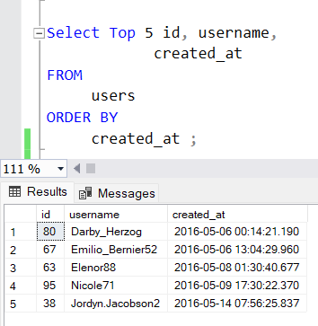
1. Loyal User Reward: The marketing team wants to reward the most loyal users, i.e., those who have been using the platform for the longest time. The following query returns the 5 oldest users on Instagram as per the provided database.
These are the oldest 5 users associated with Instagram.

Slide 7
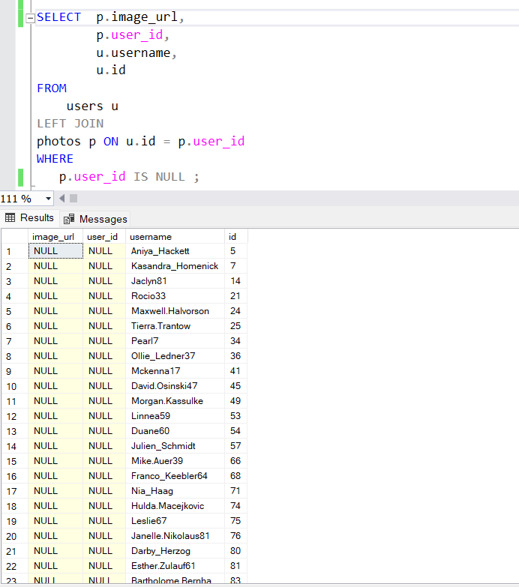
2. Inactive User Engagement: The team wants to encourage inactive users to start posting by sending them promotional emails. The query below identifies all users who have never posted anything on Instagram.
A total of 26 users have never posted any content on the site .

Slide 8
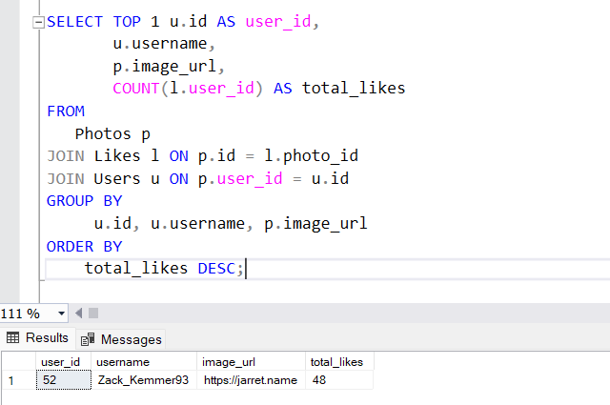
3. Contest Winner Declaration: The team has organized a contest where the user with the most likes on a single photo wins. The below mentioned query returns the user with maximum number of likes on a single photo.
Zack_Kemmer93 is the contest winner as he got the most number of likes on a single photo.

Slide 9
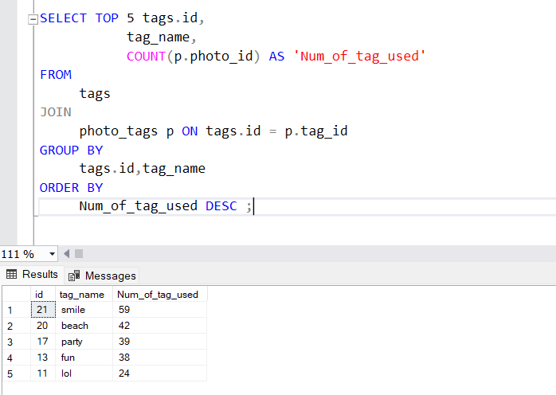
4. Hashtag Research: A partner brand wants to know the most popular hashtags to use in their posts to reach the most people. This query highlights the 5 most popular tags with the number of times they has been used.
These 5 Hashtags are the most popular on Instagram having the highest number of appearance.

Slide 10
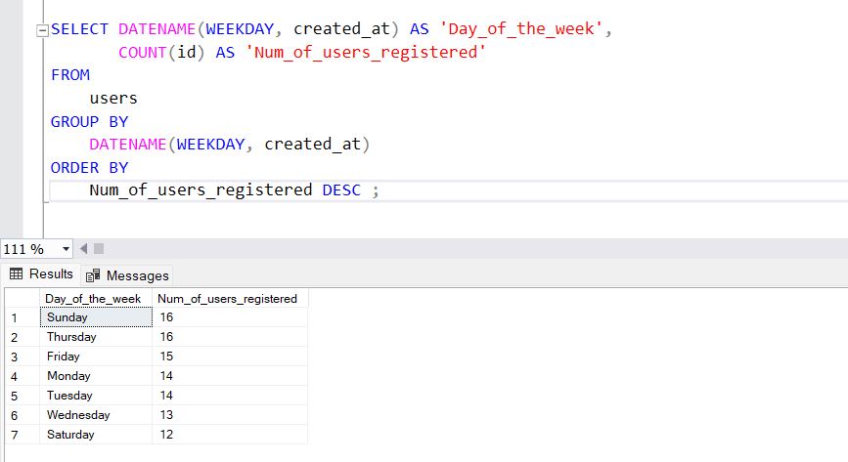
5. Ad Campaign Launch: The team wants to know the best day of the week to launch ads. This query tells us the days name with number of user’s registered on that day. This query returns the name of the days along with the number of users registered on that particular day.
Sunday and Thursday are the peak engaging having highest number of registrations on a single day.

Slide 11
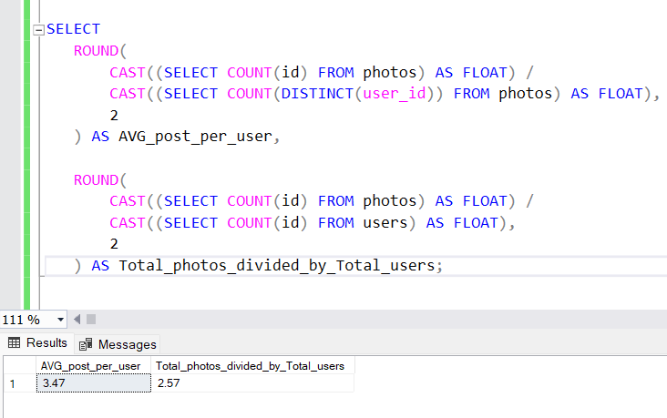
B) Investor Metrics : - 1. User Engagement: Investors want to know if users are still active and posting on Instagram or if they are making fewer posts. This query returns two metrics :- (i) Average posts per user (users who have posted) (ii) Total photos divided by total users (including inactive)
Average number of photos posted by users is 3.47 on Instagram.

Slide 12
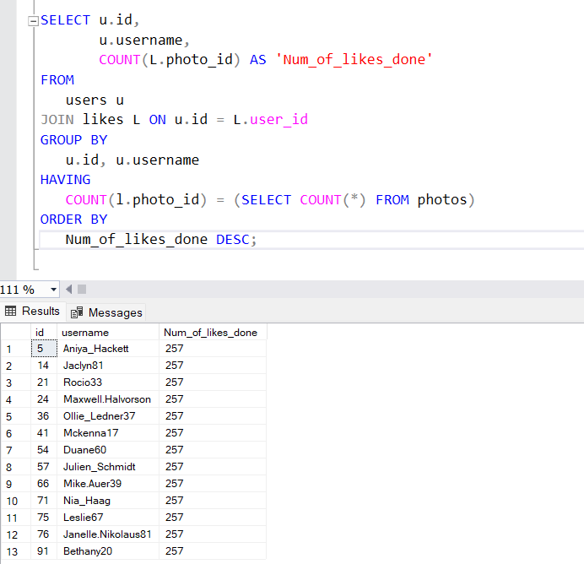
2. Bots & Fake Accounts: Investors want to know if the platform is crowded with fake and dummy accounts. The below mentioned query returns all the users who have liked on every single photo on the site, we have marked them potential bots or Fake accounts as this is typically not possible for a normal user.
There are 13 users who have been identified as Bots or Fake accounts based on the given parameter.

Slide 13
Key Findings
Inactive Users: A total of 26 user accounts have been identified as inactive, meaning they have never posted any content on the platform.
Contest Winner: A contest was held to identify the user with the most likes on a single photo. The winner was Zack_kemmer93, who received the highest number of likes on a single post.
Peak Engagement Days: Analysis reveals that Sunday and Thursday are the most engaging days on the platform, with 16 user registrations on each which is the highest compared to other days.
Popular Hashtags: The hashtags #Smile and #Beach emerged as the most frequently used, appearing 59 and 42 times respectively, making them the top-performing tags.
Average Posts per User: The platform has an average of 3.47 posts per user, indicating healthy content contribution across the user base.
Potential Bots or Fake Accounts: 13 user accounts have been marked as potential bots or fake users, as they have liked every single photo on the platform, a behavior that is unlikely for a genuine user.

Slide 14
Recommendations
Re-engage Inactive Users : We can launch personalized email or in-app campaigns encouraging inactive users to post their first photo.
Leverage High Engagement Days : Schedule promotional events, content challenges, marketing campaigns or sponsored posts on Sundays and Thursdays to capitalize on peak user activity.
Highlight Top Content Creators : Feature contest winners like Zack_kemmer93 to motivate other users and create a sense of healthy competition. We can introduce a "Photo of the Week" or "Top Creator" section.
Detect and Remove Fake Accounts : Strengthen bot detection by flagging accounts with abnormal engagement patterns (e.g., liking every photo). Implement CAPTCHA challenges or email verification for suspicious activity.

Slide 15
Thank You

